Slide 1



Slide 2

PATNA WOMEN’S COLLEGE AUTONOMOUS 3RD CYCLE NAAC Re-Accredited-’A’ Grade with CGPA -3.58/4
SUBMITTED BY-
Mamta Kumari(31)
Kajal Kumari(55)
Kumari Anjali(56)

Slide 3

patna women’s college
Patna Women’s College was founded in 1940 by Bishop B.J. Sullivan S.J., Bishop of Patna and Mother M. Josephine A.C. Superior General of the Apostolic Carmel. It was the first institution of higher learning opened to cater to the educational needs of women in Bihar. Bishop Sullivan, the founder, named it Patna Women’s College and presented it as a gift to the Women of Bihar, thereby placing at their disposal an opportunity for higher edit was Bishop Sullivan’s firm belief that the upliftment of Bihar lay in liberating its womenfolk by providing them with opportunities for higher education, in other words, by empowering them. In the early years the College and the hostel were housed in the Bishop’s own residence at Bankipur, which he vacated for this great work.
The College was granted the status of degree college in July 1941. The site for the College building was offered to the then Principal, Mother Theodosia by the Governor of Bihar Lord Rutherford in 1945. The Governor was concerned that the College building should match in beauty the High Court opposite which this site was located. He was not disappointed. Father Gerhard and Father Loesch saw an ‘architect’s dream’ for the new building of Patna Women’s College, a unique synthesis of Hindu, Islamic, Norman and Gothic styles. The College moved into the new building in July 1948. Thousands of motivated and empowered women have passed through the portals of this college and have entered various fields of life, many making a mark in our country and abroad.
The College has come a long way from the time the pioneers envisioned and undertook the difficult task of establishing a Women’s College at a time when only a few truly enlightened and far-sighted persons were prepared to support this infant project in a place where higher education for women was frowned upon, if not rejected outright.
cation.

Slide 4

Developed by:=
Mamta kumari
Kajal kumari
Kumari anjali

Slide 5

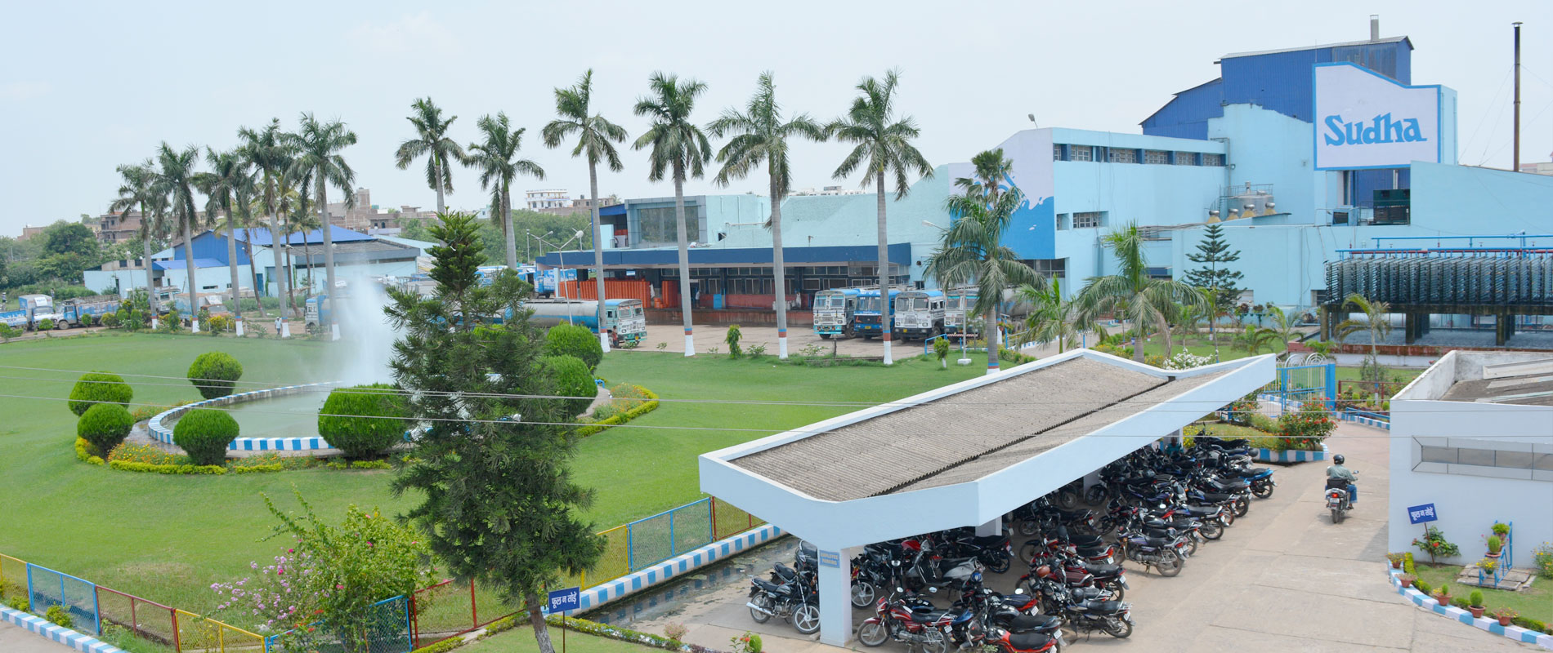
Name of the organisation PATNA DAIRY PROJECT
Project Name:-
PRODUCT MARKETING MANAGEMENT SYSYTEM

Slide 6


PATNA DAIRY PROJECT

Slide 7

“Patna Dairy Project (PDP)” was started at 1st October, 1981 through the National Dairy Development Board (NDDB).NDDB handed over the arrangements of Patna Dairy Project (PDP) to Vaishal Patliputra Dugdh Utpadak Sahkari Sangh Ltd.(VPDUSS) with effect from 1st July, 1988.The Company is certified by Bureau of Indian Standards in March, 2002.
A Corporation know as Bihar State Dairy Corporation was formed in the year 1972 for speedy and effective implementation of the Operation Flood programme in the state. The Dairy Corporation was to develop the Dairy Cooperatives both at the village level and milk shed level cooperative would take over the entire infrastructure created in due course.
The Corporation positioned a multi disciplinary Procurement & Inputs wing in 1975 after their recruitment and training. A Spread Head Team (SHT) was deputed from National Dairy Development Board (NDDB) from the same year for helping the Corporation in organizing and developing the Cooperatives. Though the progress in the initial years was encouraging, the programme, for obvious reasons could not achieve the goals for which it was established.
Subsequently, the State Government felt it worthwhile to request the DAIRY BOARD (NDDB) for taking over the infrastructure created on management basis. The National Dairy Development Board (NDDB)took over the management of the infrastructure with effect from 1st October, 1981 under the banner of Patna Dairy Project (PDP).

Slide 8

PRODUCT MARKETING MANAGEMENT SYSTEM

Slide 9

Product marketing is a process of promoting and selling a product to a customer. Also product marketing is defined as being the intermediary function between product development and increasing brand awareness. For example, product management deals with the basics of product development within a firm, whereas product marketing deals with marketing the product to prospects, customers, and others. Product marketing, as a job function within a firm, also differs from other marketing jobs such as social media marketing , marketing communications , online marketing, advertising, marketing strategy, and public relations, although product marketers may use channels such as online for outbound marketing for their product. A product market is something that is referred to when pitching a new product to the general public. Product market definition focuses on a narrow statement: the product type, customer needs (functional needs), customer type, and geographic area.

Slide 10


As per the processes defined by the management team and our Project Guide SURESH SIR.
For this, the organization maintains two types of authorization that is :
ADMINISTRATOR
USER

Slide 11
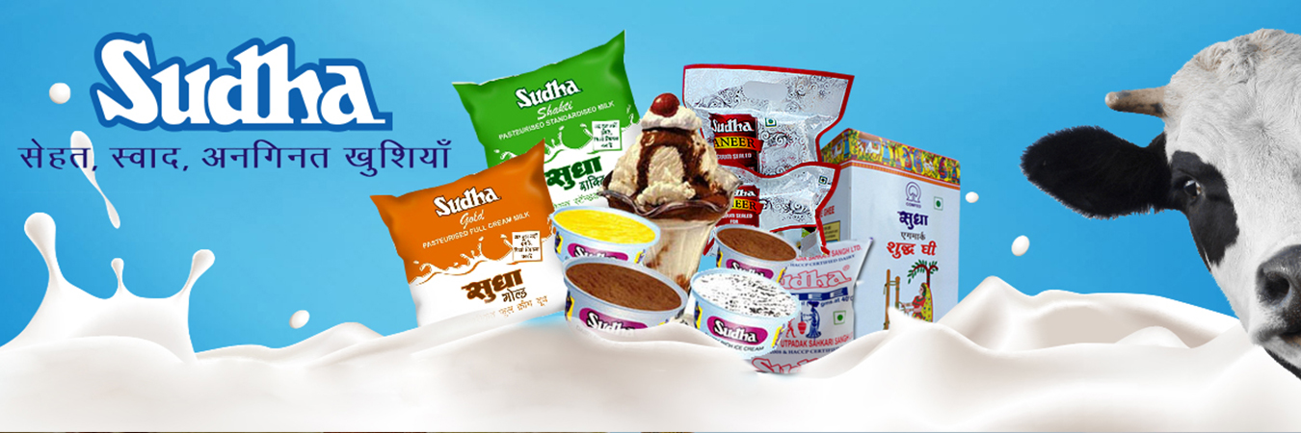
OBJECTIVE

Slide 12

To make the interface user friendly
Ultimately, facilitate a comprehensive design around these needs.

Slide 13

OPERATING SYSTEM - WINDOWS 7
FRONT END – JAVA (JDK 8.1)
BACK END - ORACLE 11g

Slide 14



NOTEPAD++
SUBLIME TEXT

Slide 15


EXISTING SYSTEM

Slide 16

Whenever we implement new system it is developed to remove the shortcomings of an existing system. It is important to update the outdated system to cope up with the changing world . We are doing a project on
“ PRODUCT MARKETING MANAGEMENT PRODUCT” . The existing system is outdated as it was developed using COBOL and FoxPro. Its performance is slow and it have some more disadvantages .

Slide 17



PROPOSED SYSTEM

Slide 18


It will be a
Desktop based dynamic Application Software

Slide 19


ENTITY RELATIONSHIP
DIAGRAM

Slide 20
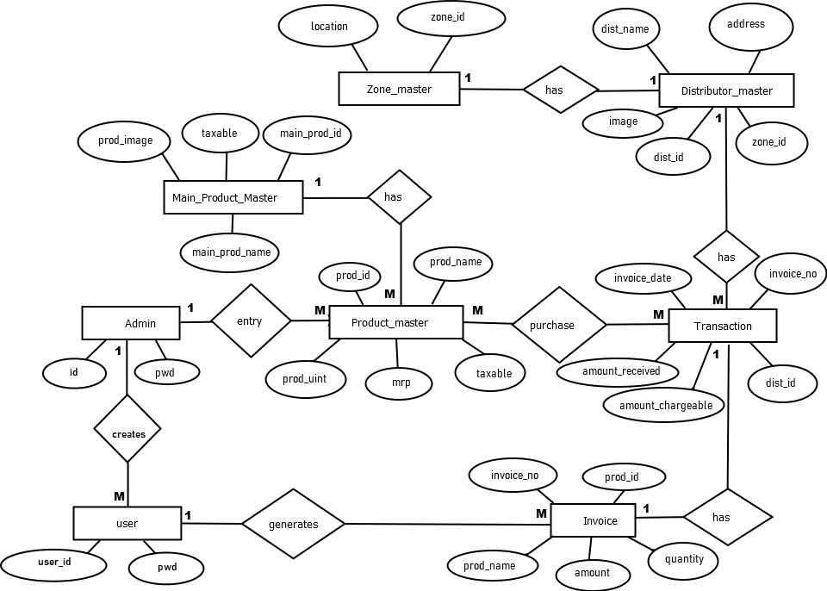

Slide 21


DATA FLOW DIAGRAM

Slide 22
SYMBOLS REPRESENT
ENTITY
FLOW OF DATA
PROCESS
DATA STORE

Slide 23
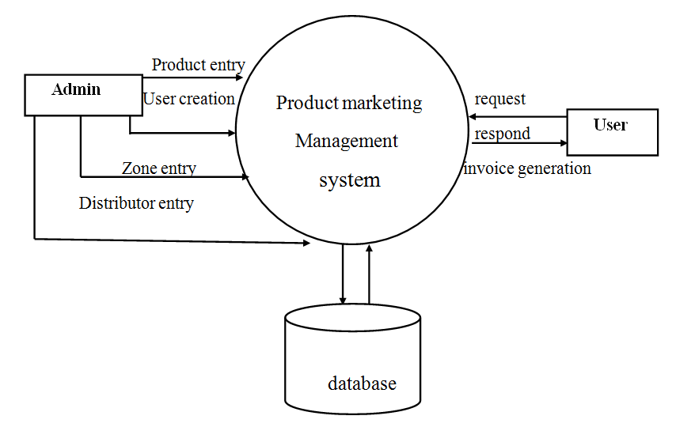
Context level diagram

Slide 24
1 level dfd

Slide 25
1 Level dfd

Slide 26

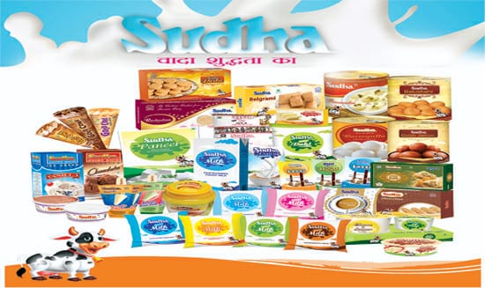
TO OUR SOFTWARE

Slide 27
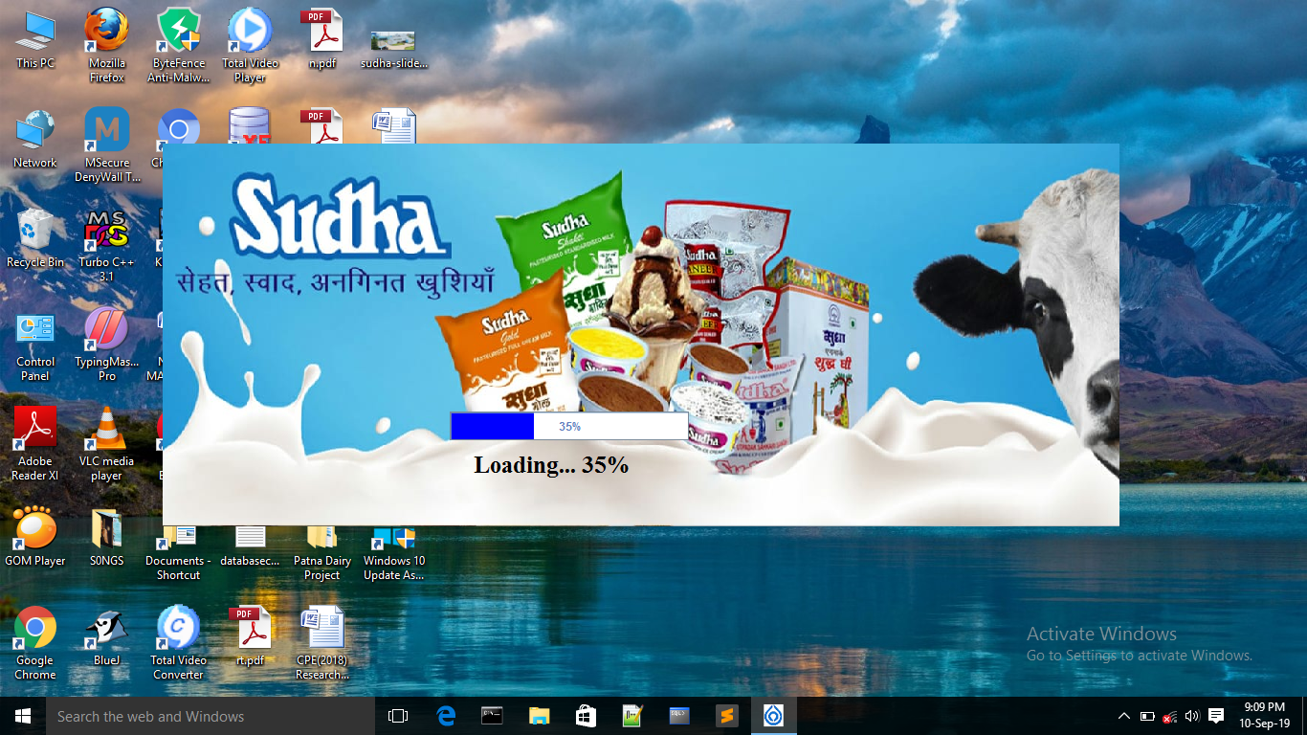
Splash screen

Slide 28
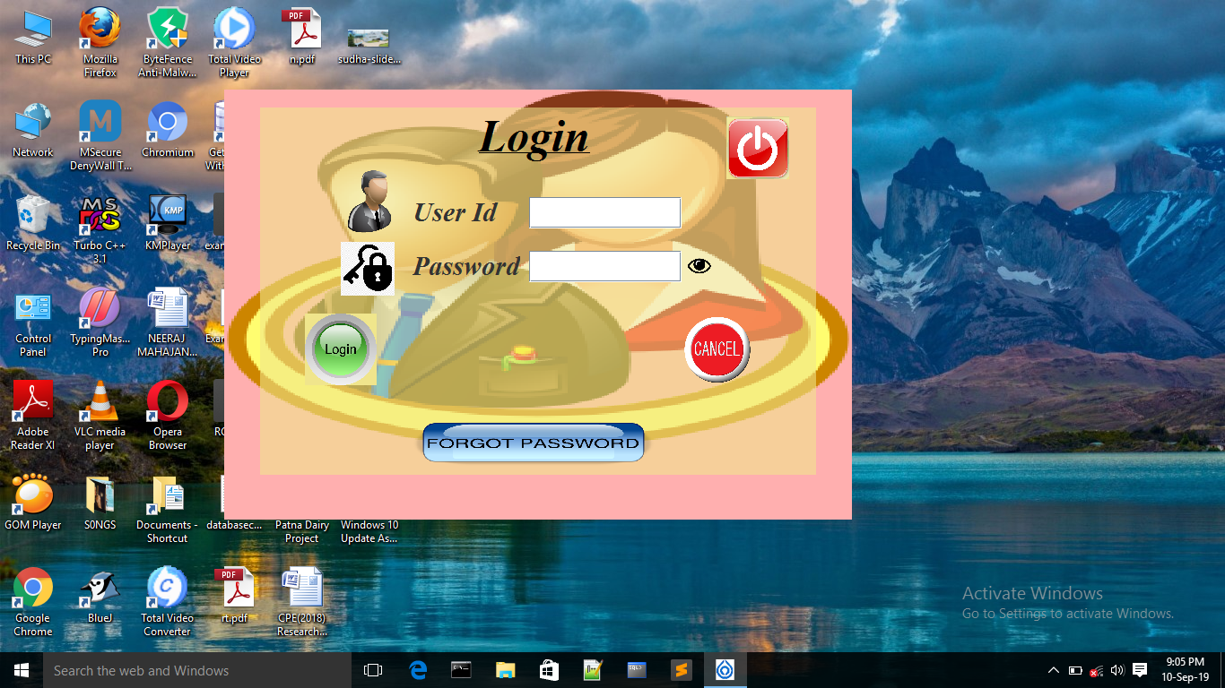
Login form

Slide 29
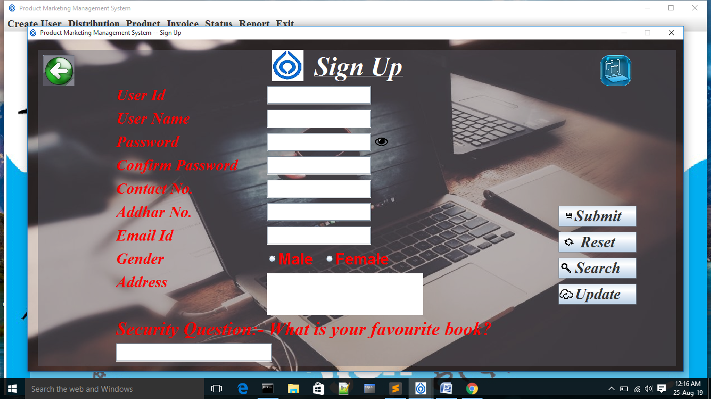
Sign up form

Slide 30
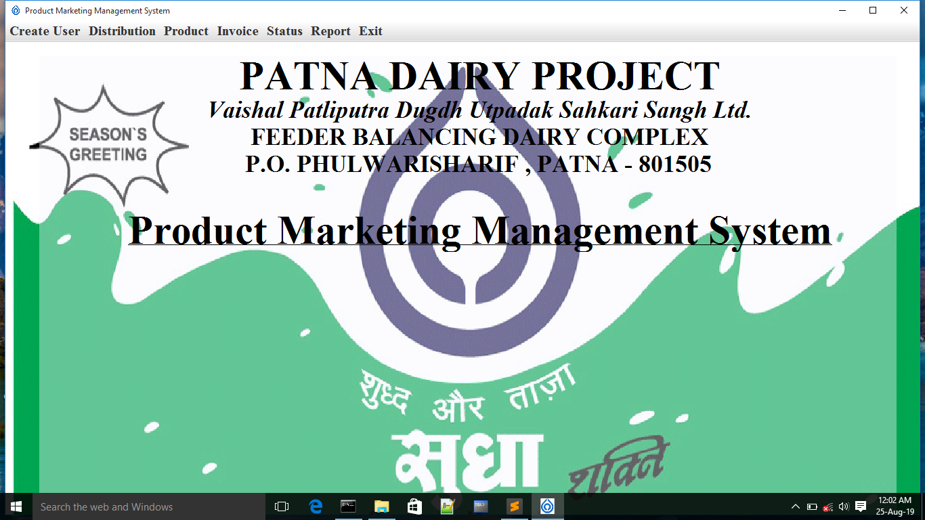
menu form

Slide 31
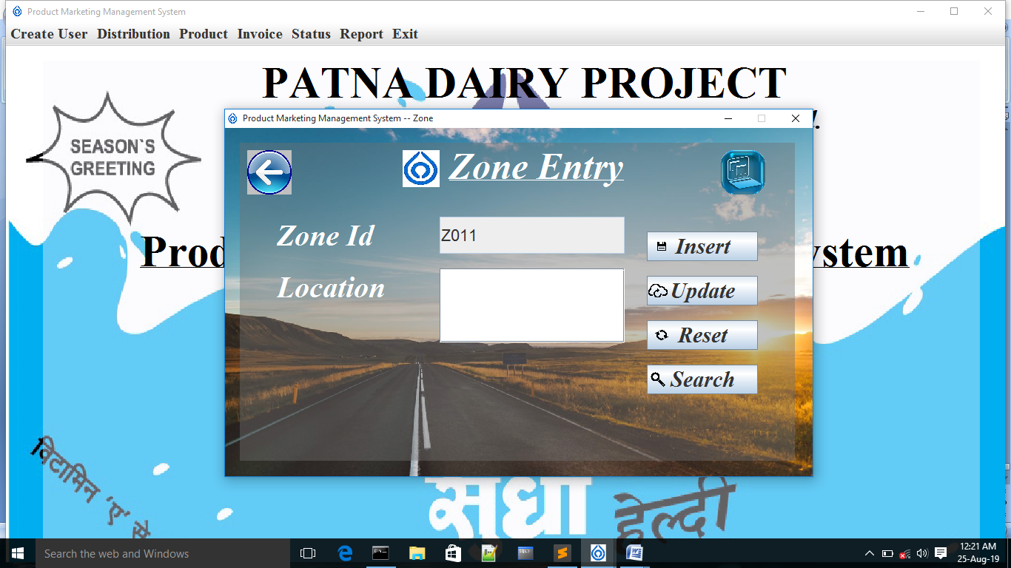
Zone entry form

Slide 32
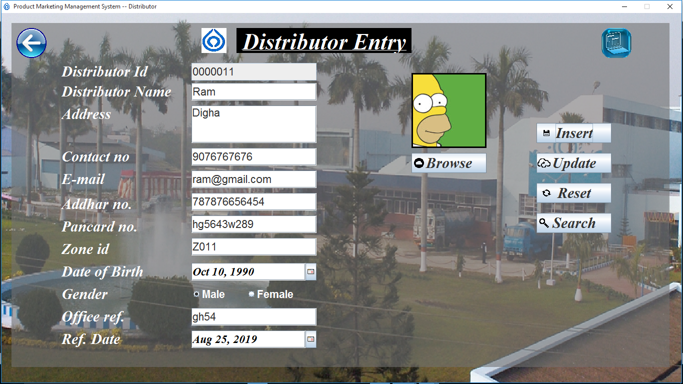
Distributer entry form

Slide 33
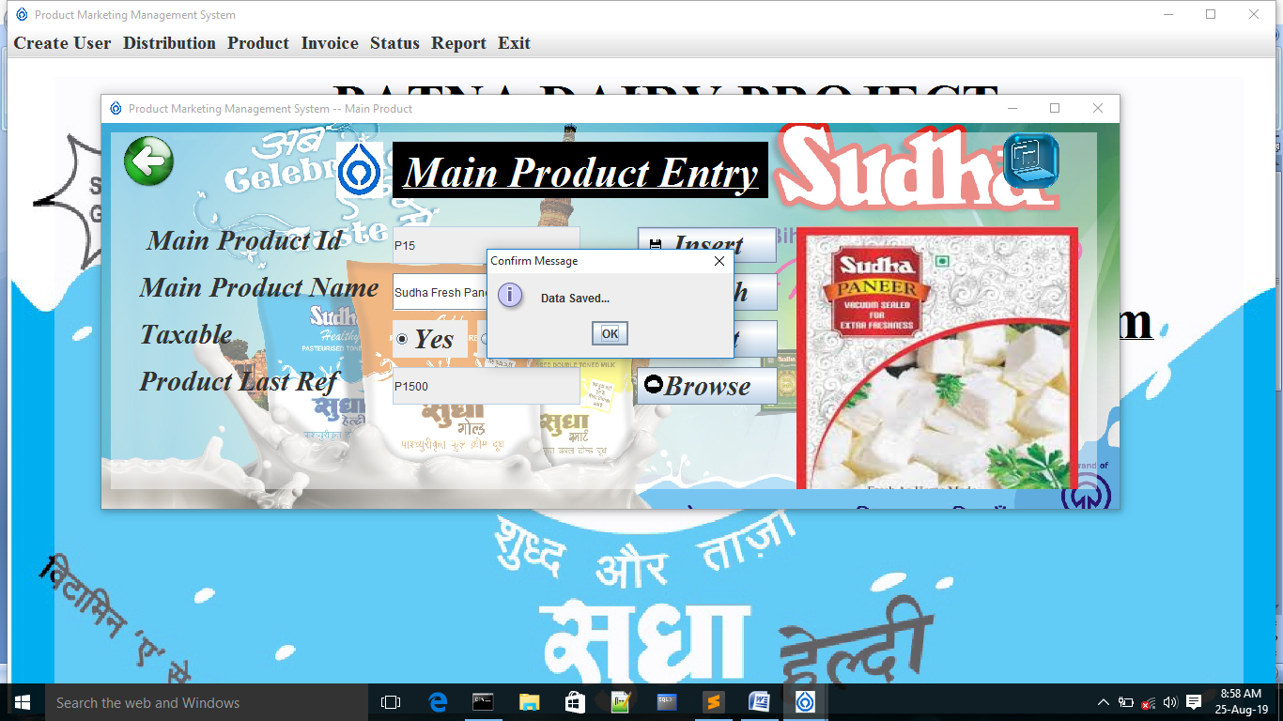
Main product entry

Slide 34
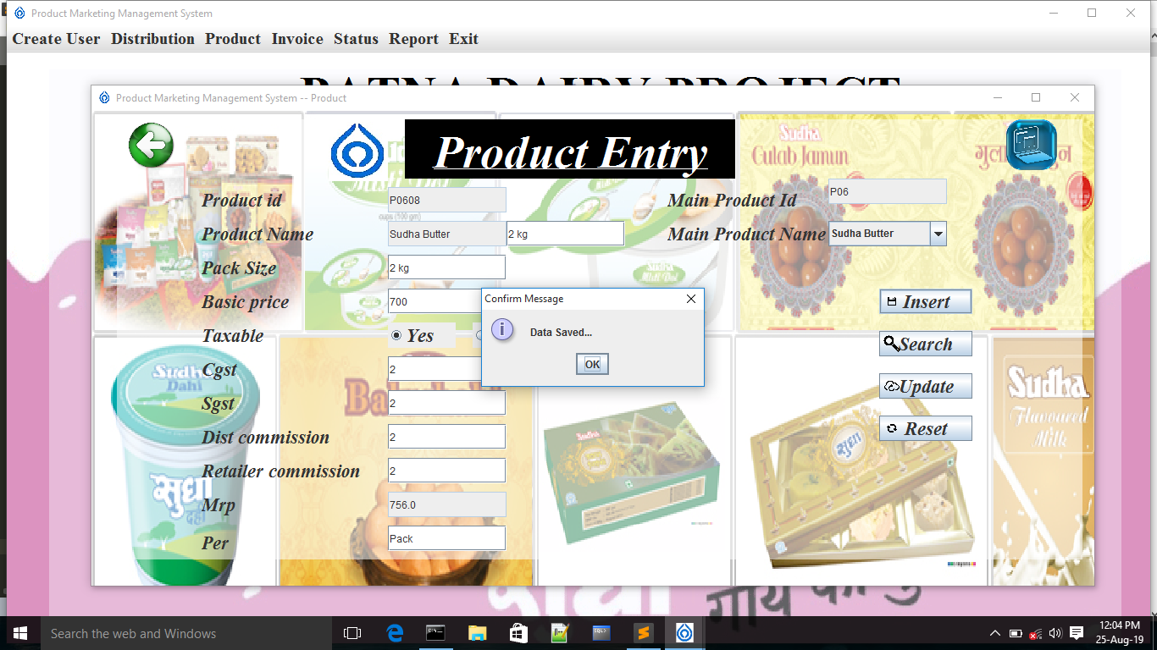
Product entry form

Slide 35
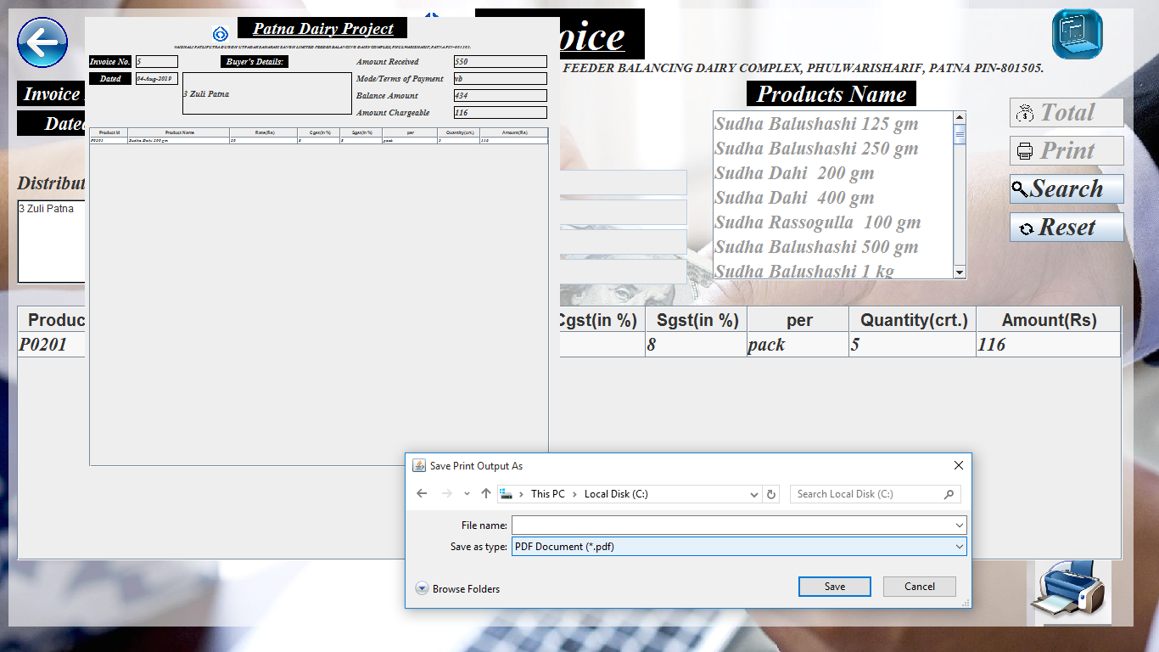
Transaction form

Slide 36
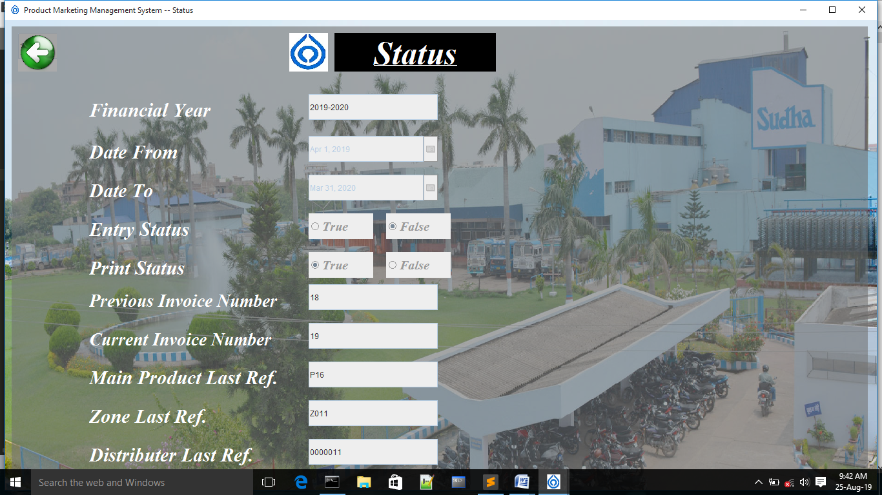
Status form

Slide 37
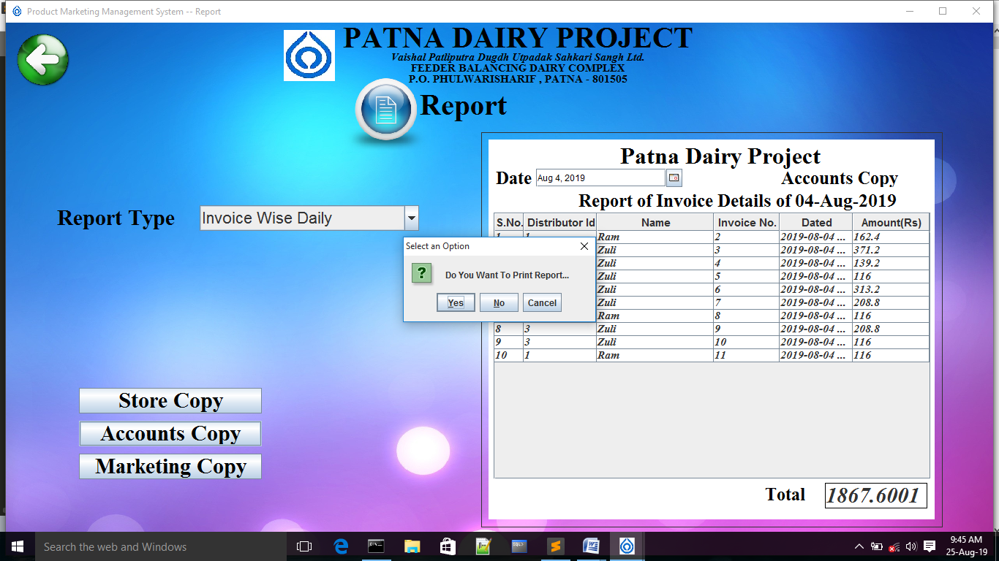
Report form

Slide 38

PROJECT MAINTENANCE

Slide 39

The implementation process contains software preparation and transition activities.
Software maintenance is a very broad activity that includes:
Error correction
Enhancements of capabilities
Deletion of obsolete capabilities
Optimization.
Because, change is inevitable, mechanisms must be developed for evaluation, controlling and making modifications in the project.

Slide 40


FUTURE SCOPE
There are many future scope is mentioned below:
In future our system can include online transaction facility.
System is so much flexible so in future it can increase easily and new modules can be added easily.

Slide 41


LIMITATIONS

Slide 42
JUST A
DESKTOP BASED
APPLICATION SOFTWARE

Slide 43



Slide 44


Working on the project
“PRODUCT MARKETING MANAGEMENT SYSTEM”
A great learning experience.
It helped us giving technical as well as interpersonal skills and we can definitely say that this period will always act as a stepping stone in our career as software professional.

Slide 45



Slide 46




Slide 47


Any Questions ??

